Slide 1
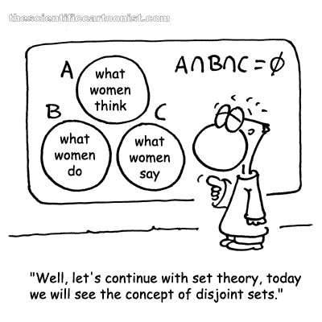
Chapter 1: Outcomes, Events, and Sample Spaces
men
men
men
http://www.thescientificcartoonist.com/?p=102

Slide 2
Notation
 | Integers
 | Natural numbers
 | Real Numbers
 | Fractions

Slide 3
Part 1
What this part is about
Objectives for the part
Math Skills
Resources

Slide 4
Objectives (1)
Define basic terms related to probability and events.
Use proper set notation for events.
Characterize the possible outcomes, when something random occurs.
Describe the events into which outcomes can be grouped
Assign probabilities to events
Perform calculations using probability rules

Slide 5
Objectives (2)
Calculate whether two or more events are independent.
Calculate the probability of an event occurring, given that another event occurred.
Calculate the conditional probability of an event using Bayes’ Theorem

Slide 6
Set Notation
$$\left\{\begin{matrix}things \\ in the set\end{matrix} | \begin{matrix}conditions on \\ these things\end{matrix}\right\}$$
Subset: part of a set
x ∈ A

Slide 7
Venn Diagrams
Graphical way to describe sets
A
S

Slide 8
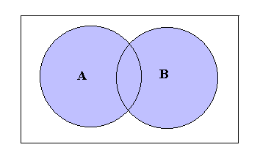
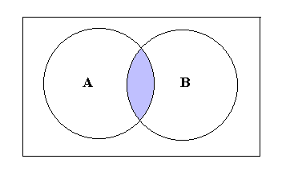
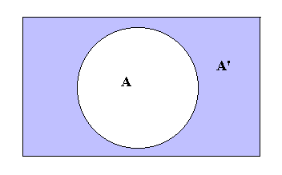
Set Theory
S
S
Union: A U B
Intersection: A ∩ B
S
S
Complement: A^{C}
Setminus: A\B

Slide 9
Set Theory: Laws
Let A, B, and C be subsets of S. Then
Distributive Laws
a) A ∩ (B U C) = (A ∩ B) U (A ∩ C)
b) A U (B ∩ C) = (A U B) ∩ (A U C)
Commutative Laws
a) A ∩ B = B ∩ A
b) A U B = B U A
Associative Laws
a) A ∩ (B ∩ C) = (A ∩ B) ∩ C
b) A U (B U C) = (A U B) U C

Slide 10
DeMorgan’s Laws
Theorem 1.23 DeMorgan’s first law
For a finite or infinite collection of events, A₁, A₂, …
(A U B)^{C} = A^{C} ∩ B^{C}
Theorem 1.24 DeMorgan’s second law
For a finite or infinite collection of events, A₁, A₂, …
(A ∩ B)^{C} = A^{C} U B^{C}

Slide 11
Cartesian Product
All possible combinations.
A₁ = {1,2} A₂ = {a,b}
A₁ X A₂ = {(1,a), (1,b), (2,a), 2,b)}

